Slide 1

CSC/CPE 138 - Computer Network Fundamentals
Introduction
The presentation was adapted from the textbook: Computer Networking: A Top-Down Approach 8th edition Jim Kurose, Keith Ross, Pearson, 2020

Slide 2

Chapter 1: roadmap
What is the Internet?
What is a protocol?
Network edge: hosts, access network, physical media
Network core: packet/circuit switching, internet structure
Performance: loss, delay, throughput
Security
Protocol layers, service models
History

Slide 3
Protocol “layers” and reference models
Networks are complex,
with many “pieces”:
hosts
routers
links of various media
applications
protocols
hardware, software
Question: is there any hope of organizing structure of network?
and/or our discussion of networks?

Slide 4
Example: organization of air travel
end-to-end transfer of person plus baggage
ticket (purchase)
baggage (check)
gates (load)
runway takeoff
airplane routing
ticket (complain)
baggage (claim)
gates (unload)
runway landing
airplane routing
airplane routing
How would you define/discuss the system of airline travel?
a series of steps, involving many services

Slide 5
Example: organization of air travel
ticket (purchase)
baggage (check)
gates (load)
runway takeoff
airplane routing
ticketing service
ticket (complain)
baggage (claim)
gates (unload)
runway landing
airplane routing
baggage service
gate service
runway service
routing service
airplane routing
layers: each layer implements a service
via its own internal-layer actions
relying on services provided by layer below

Slide 6
Why layering?
Approach to designing/discussing complex systems:
explicit structure allows identification, relationship of system’s pieces
layered reference model for discussion
modularization eases maintenance, updating of system
change in layer's service implementation: transparent to rest of system
e.g., change in gate procedure doesn’t affect rest of system

Slide 7
Layered Internet protocol stack
application: supporting network applications
HTTP, IMAP, SMTP, DNS
transport: process-process data transfer
TCP, UDP
network: routing of datagrams from source to destination
IP, routing protocols
link: data transfer between neighboring network elements
Ethernet, 802.11 (WiFi), PPP
physical: bits “on the wire”
application
application
transport
transport
network
network
link
link
physical
physical

Slide 8

Services, Layering and Encapsulation
application
transport
network
link
physical
M
application
transport
network
link
physical
Application exchanges messages to implement some application service using services of transport layer
H_{t}
M
Transport-layer protocol transfers M (e.g., reliably) from one process to another, using services of network layer
transport-layer protocol encapsulates application-layer message, M, with transport layer-layer header H_{t} to create a transport-layer segment
H_{t} used by transport layer protocol to implement its service
TCP or UDP
source
destination

Slide 9
Services, Layering and Encapsulation
application
transport
network
link
physical
M
application
transport
network
link
physical
H_{t}
M
Transport-layer protocol transfers M (e.g., reliably) from one process to another, using services of network layer
H_{n}
H_{t}
M
Network-layer protocol transfers transport-layer segment [H_{t} | M] from one host to another, using link layer services
network-layer protocol encapsulates transport-layer segment [H_{t} | M] with network layer-layer header H_{n} to create a network-layer datagram
H_{n} used by network layer protocol to implement its service
source
destination

Slide 10
Services, Layering and Encapsulation
H_{n}
H_{t}
M
application
transport
network
link
physical
M
application
transport
network
link
physical
H_{t}
M
H_{n}
H_{t}
M
Network-layer protocol transfers transport-layer segment [H_{t} | M] from one host to another, using link layer services
H_{l}
H_{n}
H_{t}
M
Link-layer protocol transfers datagram [H_{n}| [H_{t} |M] from host to neighboring host, using network-layer services
link-layer protocol encapsulates network datagram [H_{n}| [H_{t} |M], with link-layer header H_{l} to create a link-layer frame
source
destination

Slide 11
Services, Layering and Encapsulation
application
transport
network
link
physical
M
application
transport
network
link
physical
M
message
H_{t}
M
H_{t}
M
segment
H_{n}
H_{t}
M
H_{n}
H_{t}
M
datagram
H_{l}
H_{n}
H_{t}
M
H_{l}
H_{n}
H_{t}
M
frame
source
destination

Slide 12





Encapsulation
Matryoshka dolls (stacking dolls)
message
segment
datagram
frame
Credit: https://dribbble.com/shots/7182188-Babushka-Boi

Slide 13
Services, Layering and Encapsulation
application
transport
network
link
physical
application
transport
network
link
physical
message
M
M
segment
H_{t}
M
H_{t}
M
datagram
H_{n}
H_{t}
M
H_{n}
H_{t}
M
frame
H_{l}
H_{n}
H_{t}
M
H_{l}
H_{n}
H_{t}
M
source
destination

Slide 14
Encapsulation: an end-end view
source
message
M
application
transport
network
link
physical
segment
H_{t}
M
H_{t}
datagram
H_{n}
H_{t}
H_{n}
M
frame
H_{l}
H_{n}
H_{t}
M
link
physical
switch
destination
H_{n}
H_{t}
M
network
link
physical
M
application
transport
network
link
physical
H_{l}
H_{n}
H_{t}
M
H_{n}
H_{t}
M
H_{t}
M
H_{n}
H_{t}
M
H_{l}
H_{n}
H_{t}
M
router

Slide 15
Chapter 1: roadmap
What is the Internet?
What is a protocol?
Network edge: hosts, access network, physical media
Network core: packet/circuit switching, internet structure
Performance: loss, delay, throughput
Security
Protocol layers, service models
History

Slide 16
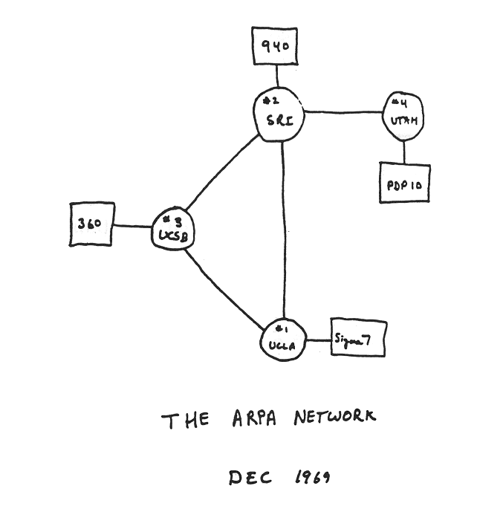
Internet history
1961-1972: Early packet-switching principles
1961: Kleinrock - queueing theory shows effectiveness of packet-switching
1964: Baran - packet-switching in military nets
1967: ARPAnet conceived by Advanced Research Projects Agency
1969: first ARPAnet node operational
1972:
ARPAnet public demo
NCP (Network Control Protocol) first host-host protocol
first e-mail program
ARPAnet has 15 nodes

Slide 17
Internet history
1972-1980: Internetworking, new and proprietary networks
1970: ALOHAnet satellite network in Hawaii
1974: Cerf and Kahn - architecture for interconnecting networks
1976: Ethernet at Xerox PARC
late70’s: proprietary architectures: DECnet, SNA, XNA
1979: ARPAnet has 200 nodes
Cerf and Kahn’s internetworking principles:
minimalism, autonomy - no internal changes required to interconnect networks
best-effort service model
stateless routing
decentralized control
define today’s Internet architecture

Slide 18
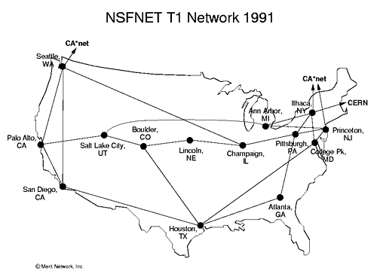
Internet history
1980-1990: new protocols, a proliferation of networks
1983: deployment of TCP/IP
1982: smtp e-mail protocol defined
1983: DNS defined for name-to-IP-address translation
1985: ftp protocol defined
1988: TCP congestion control
new national networks: CSnet, BITnet, NSFnet, Minitel
100,000 hosts connected to confederation of networks

Slide 19
Internet history
1990, 2000s: commercialization, the Web, new applications
early 1990s: ARPAnet decommissioned
1991: NSF lifts restrictions on commercial use of NSFnet (decommissioned, 1995)
early 1990s: Web
hypertext [Bush 1945, Nelson 1960’s]
HTML, HTTP: Berners-Lee
1994: Mosaic, later Netscape
late 1990s: commercialization of the Web
late 1990s – 2000s:
more killer apps: instant messaging, P2P file sharing
network security to forefront
est. 50 million host, 100 million+ users
backbone links running at Gbps

Slide 20
Internet history
2005-present: scale, SDN, mobility, cloud
aggressive deployment of broadband home access (10-100’s Mbps)
2008: software-defined networking (SDN)
increasing ubiquity of high-speed wireless access: 4G/5G, WiFi
service providers (Google, FB, Microsoft) create their own networks
bypass commercial Internet to connect “close” to end user, providing “instantaneous” access to social media, search, video content, …
enterprises run their services in “cloud” (e.g., Amazon Web Services, Microsoft Azure)
rise of smartphones: more mobile than fixed devices on Internet (2017)
~15B devices attached to Internet (2023, statista.com)

Slide 21
Chapter 1: summary
We’ve covered a “ton” of material!
Internet overview
what’s a protocol?
network edge, access network, core
packet-switching versus circuit-switching
Internet structure
performance: loss, delay, throughput
layering, service models
security
history
You now have:
context, overview, vocabulary, “feel” of networking
more depth, detail, and fun to follow!

